Slide 1

Manuel Montoya Catalá Computer Vision Carlos III University of Madrid June, 2015
Part-based Object Detection using RealAdaBoost and ANN

Slide 2
Part-based Object Detection using RealAdaBoost and ANN
Introduction
Part Based Model
RealAdaBoost
ANN + ELM
Experiments and Evaluation
Conclusion
References
Notes:
The Web has millions of documents, we cannot perform classical information retrieval techniques on them, it takes too long, too many similarites.
They use techniques such as Indexing and Page Rang. Assign to every word combination, a list of ordered webs by relevance.
Constraint the number Webpages to a related area/s and perform better IR

Slide 3
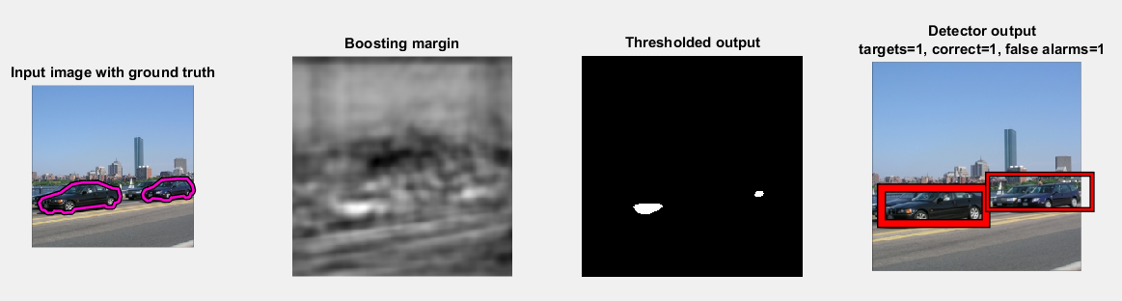
Part-based Object Detection using RealAdaBoost and ANN
Introduction
In this project we propose a part-based system for car detection.
Using a Star model for the relationship among the parts.
RealAdaBoost + Neural Nets as Classifier.
NN trained with the Extreme Learning Machine algorithm.
Results evaluated using the Precision-Recall curve.
Project is based in the Lab Session 8 – Object Detection of this subject.
Improvement on the Detector.
Notes:
The Web has become the largest available repository of data in the world.
We cannot perform classical information retrieval techniques on them, it takes too long, too many similarites.
Webbrowses use techniques such as Indexing and Page Rank. Assign to every word combination, a list of ordered webs by relevance.
Constraint the number Webpages to a related area/s and perform better IR

Slide 4


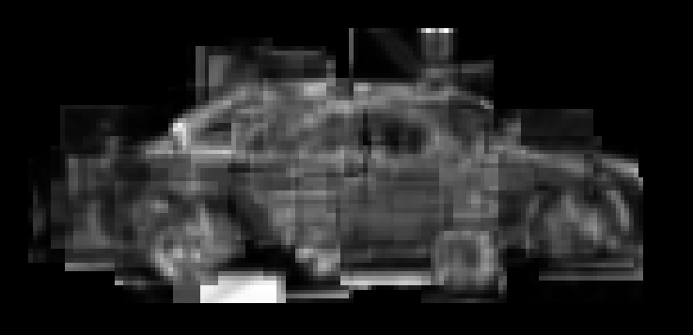
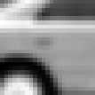


Part-based Object Detection using RealAdaBoost and ANN
Part-based Models
Objects are represented as a set of parts and their spacial relationship.
A part is any element of an object that can be reliably detected.
Parts were chosen randomly from the grountruth of 8 images from the dataset.
Car model
Notes:
We use a Spider bot to download several WebSites (HTML documents).
Then preproces those documents to Get the relevant plain text, removing HTML markups, codes and non relevant texts.
We can also obtained metadata from them.
Perform TD-IDF for every HTML document.

Slide 5


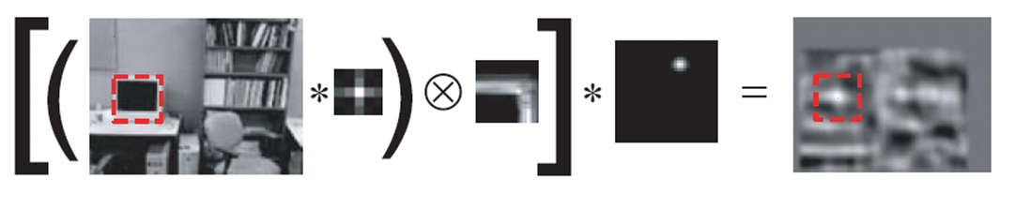








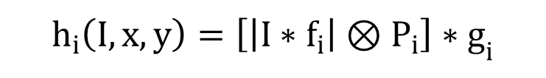
Part-based Object Detection using RealAdaBoost and ANN
Part-based Models
Each part of the model is transformed into a feature. The car-model is composed by 640 features.
Each Features composed by a triplet:
Filter
Patch
Location
640
$$h_{i}\left(I,x,y\right)=\left[\left|I∗f_{i}\right|⊗P_{i}\right]∗g_{i}$$
Notes:
We use a Spider bot to download several WebSites (HTML documents).
Then preproces those documents to Get the relevant plain text, removing HTML markups, codes and non relevant texts.
We can also obtained metadata from them.
Perform TD-IDF for every HTML document.

Slide 6
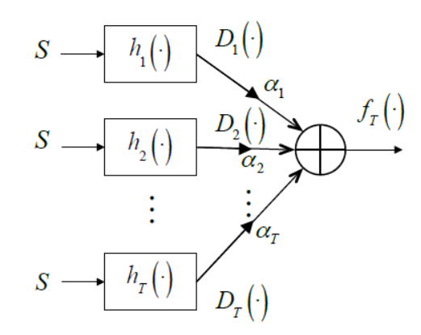
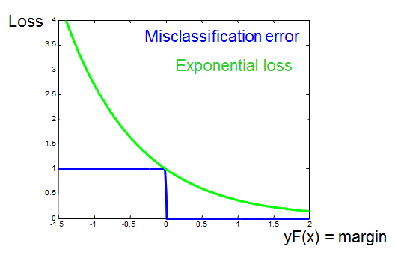

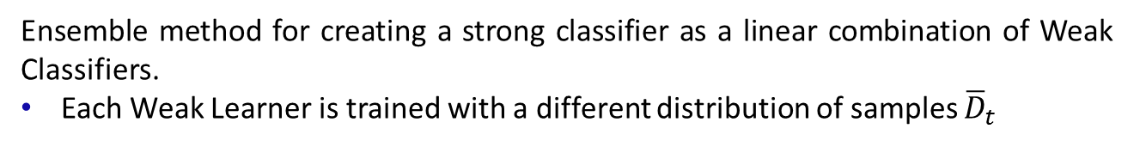
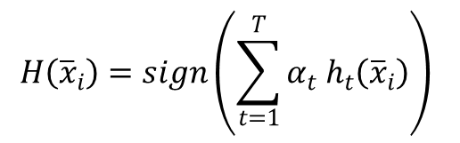
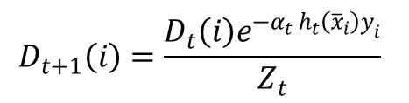
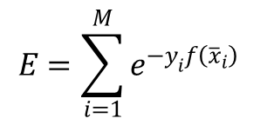
Part-based Object Detection using RealAdaBoost and ANN
RealAdaBoost
Ensemble method for creating a strong classifier as a linear combination of Weak Classifiers.
Each Weak Learner is trained with a different distribution of samples ${\overline{D}}_{t}$
$$H\left({\overline{x}}_{i}\right)=sign\left(\sum_{t=1}^{T}{α_{t} h_{t}\left({\overline{x}}_{i}\right)}\right)$$
$${\overline{D}}_{t}=\left[D_{t}\left(1\right),D_{t}\left(2\right),···,D_{t}\left(M\right)\right]$$
Update Rule:
$$D_{t+1}\left(i\right)=\frac{D_{t}\left(i\right)e^{−α_{t} h_{t}\left({\overline{x}}_{i}\right)y_{i}}}{Z_{t}}$$
Loss function:
$$E=\sum_{i=1}^{M}{e^{−y_{i}f\left({\overline{x}}_{i}\right)}}$$
Notes:
All hand-coded by scratch
All functions hand-coded by scratch.

Slide 7
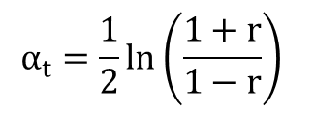
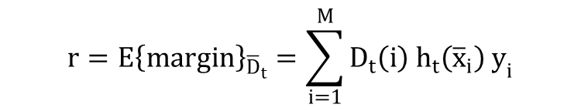
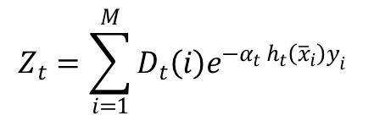
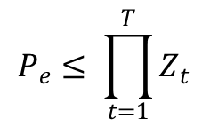
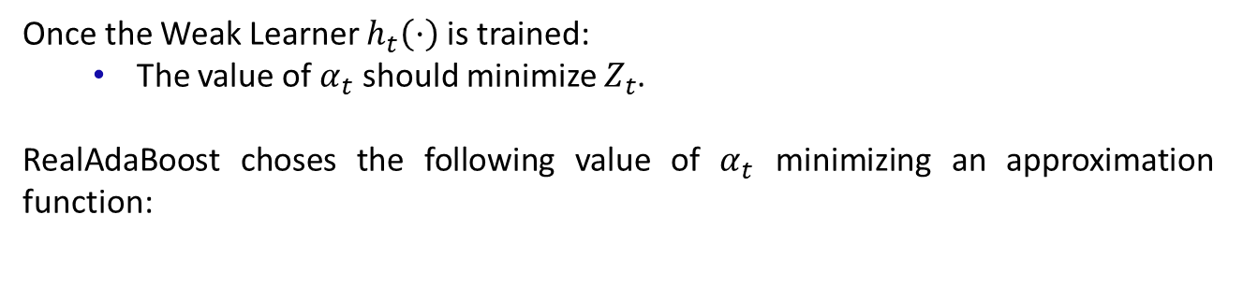
Part-based Object Detection using RealAdaBoost and ANN
RealAdaBoost
As a result of the Updating Rule, the error probability is bounded by:
$$P_{e}≤ \prod_{t=1}^{T}{Z_{t}}$$
$$Z_{t}=\sum_{i=1}^{M}{D_{t}\left(i\right)e^{−α_{t} h_{t}\left({\overline{x}}_{i}\right)y_{i}}}$$
Normalization constant
Once the Weak Learner $h_{t}\left(·\right)$ is trained:
The value of $α_{t}$ should minimize $Z_{t}$.
RealAdaBoost choses the following value of $α_{t}$ minimizing an approximation function:
$$r=E{\left\{margin\right\}}_{{\overline{D}}_{t}}=\sum_{i=1}^{M}{D_{t}\left(i\right) h_{t}\left({\overline{x}}_{i}\right) y_{i}}$$
$$α_{t}=\frac{1}{2}\ln\left(\frac{1+r}{1−r}\right)$$
Notes:
All hand-coded by scratch
All functions hand-coded by scratch.

Slide 8
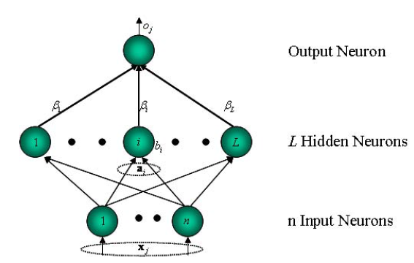
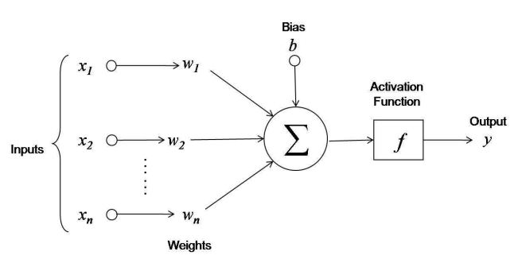
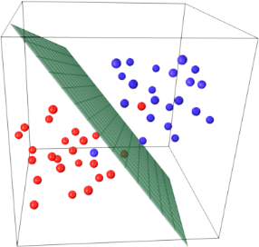
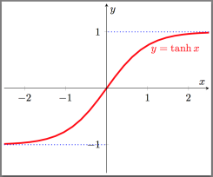

Part-based Object Detection using RealAdaBoost and ANN
ANN + ELM
Machine learning system inspired by the architecture of the mammals’ brain.
Composed by small processing units called neurons.
The neurons are interconnected and share information with each other.
Each neuron outputs a transformed linear combiantion of its input.
Neuron can be seen as a hyperplanes.
Their output is the projection of the samples over that hyperplane.
Each neuron has parameters:
$$\left\{\overline{W},b\right\}$$
Notes:
Used the URL library for the own-made spyder.

Slide 9
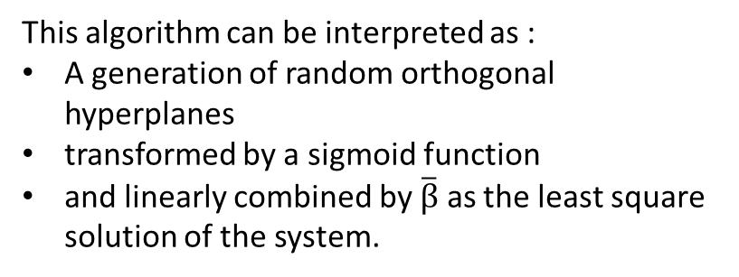
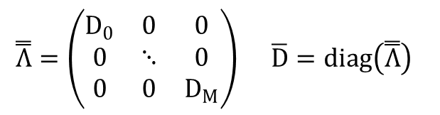
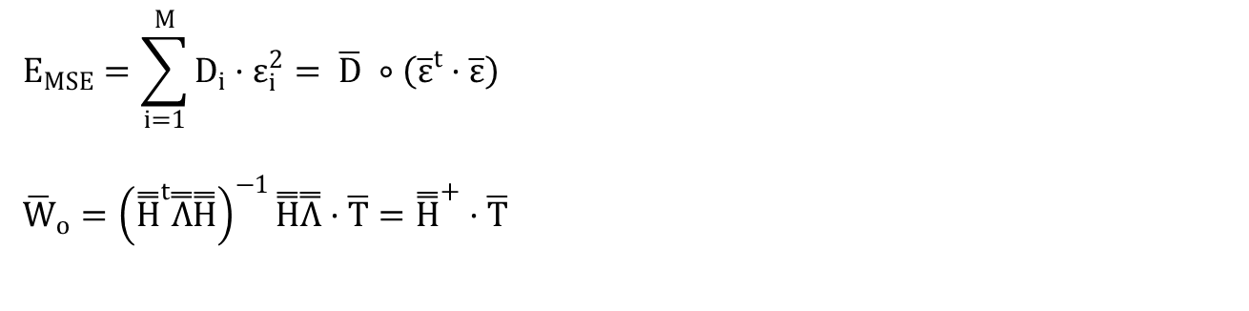
Part-based Object Detection using RealAdaBoost and ANN
ANN + ELM
Extreme Learning Machine is an algorithm to train an ANN very fast:
It randomly chooses the parameters of the hidden neurons
Computes the weights of the output neuron as Least Square Solution o
$$E_{MSE}=\sum_{i=1}^{M}{D_{i}·ε_{i}^{2}}= \overline{D} ∘\left({\overline{ε}}^{t}·\overline{ε}\right)$$
$${\overline{W}}_{o}={\left({\overset{̿}{H}}^{t}\overset{̿}{Λ}\overset{̿}{H}\right)}^{−1}\overset{̿}{H}\overset{̿}{Λ}·\overline{T}={\overset{̿}{H}}^{+}·\overline{T}$$
$$\overset{̿}{Λ}=\left(\begin{matrix}D_{0} & 0 & 0 \\ 0 & ⋱ & 0 \\ 0 & 0 & D_{M}\end{matrix}\right) \overline{D}=diag\left(\overset{̿}{Λ}\right)$$
This algorithm can be interpreted as :
A generation of random orthogonal hyperplanes
transformed by a sigmoid function
and linearly combined by $\overline{β}$ as the least square solution of the system.
Notes:
Used the URL library for the own-made spyder.

Slide 10
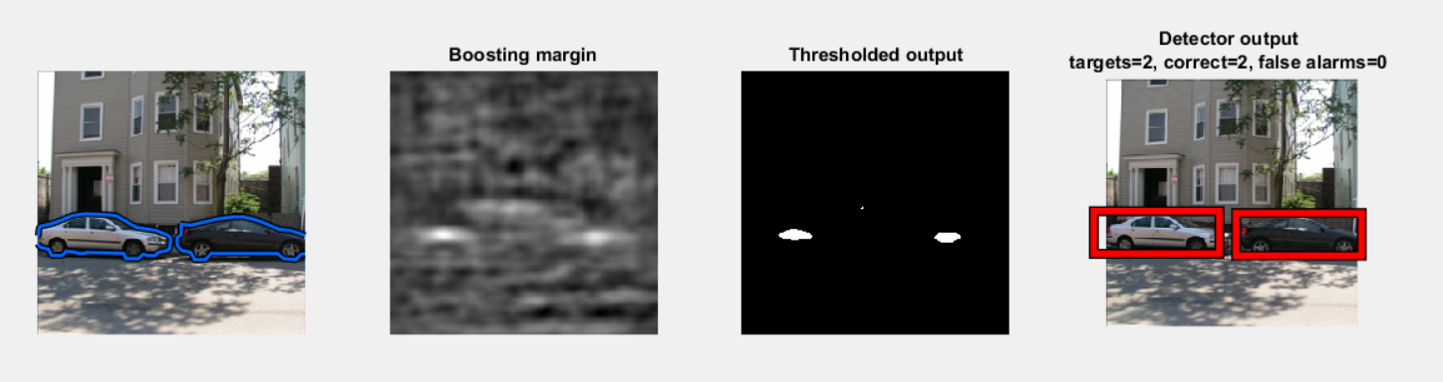
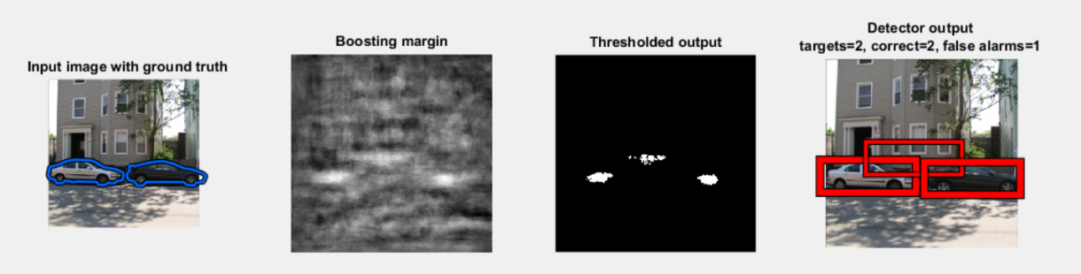
Part-based Object Detection using RealAdaBoost and ANN
Experiments Setup
The system proposed performs object recognition over the cars repository of the LabelMe Dataset. The dataset is composed of 776 images that contain cars in different scenarios; these cars appear from different points of view including partially occluded positions.
ANN + ELM Detection
Decision Stump Detection
Notes:
Difficulties: Learn Scrapy library, regular expressions (RegEx) for the rules, IO library for making files and directories. Some HMTL documents are not referenced by a document but by a folder, we need to add up a name.
Wanted to separate the downloading part from the Corpus Preprocessing Part
Example of a Crawler for Recipes.

Slide 11
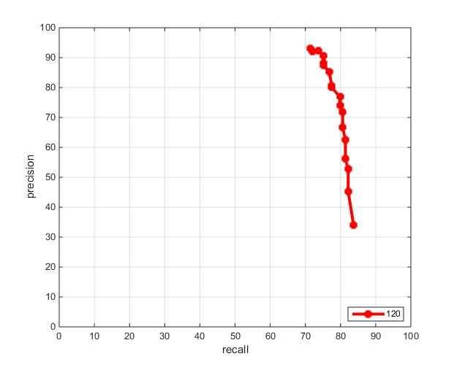
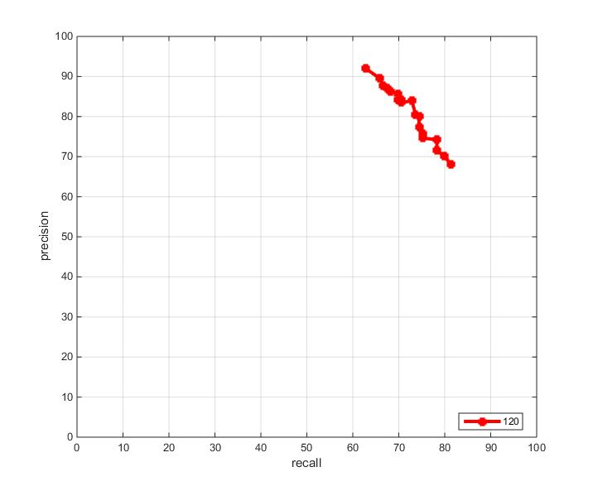


Part-based Object Detection using RealAdaBoost and ANN
Stump classifier.
Evaluation
Results were evaluated using the Precision-Recall curve:
$$precision= \frac{Number of correct objects detected}{Total number ofobjects detected}$$
$$recall= \frac{Number of objects detected}{Total number of correct objects}$$
Precision Recall for the Decision Stump
Precision Recall for the ELM-ANN
Notes:
Difficulties: Learn Scrapy library, regular expressions (RegEx) for the rules, IO library for making files and directories. Some HMTL documents are not referenced by a document but by a folder, we need to add up a name.
Wanted to separate the downloading part from the Corpus Preprocessing Part
Example of a Crawler for Recipes.

Slide 12
Part-based Object Detection using RealAdaBoost and ANN
Conclusions and Future Work
ANN + ELM + RealAdaBoost is an efficient and fast way to perfrom classification.
Although boosting is needed to avoid over-fitting, there is no need for deep boosting implementations when using an ANN trained with ELM since a single ANN is good enough for performing a basic classification.
Having the number of hidden neurons as a parameter increases the adaptability of the classifier, therefore potentially improving the results.
Future Work:
Train each ANN weak learner over a random subset of the features
Implement the pre-detection filter that removes small false alarms.
Perform multi-scale detection.
Notes:
This will reduce the over fitting and computational cost of the algorithm. It will increase diversity which will benefit boosting. Adding the selection of features as parameter of the weak learner can really boost the classifier.

Slide 13
Web Search using IR Manuel Montoya
References
[1]
Lab Session 8 – Object Detection from C4.278.12995-1 COMPUTER VISION 14/15-S2.
[2]
Antonio Torralba and Bryan Russell , “LabelMe Toolbox: MATLAB Toolbox for the LabelMe Image Database”, 2008 MIT, Computer Science and Artificial Intelligence Laboratory. http://people.csail.mit.edu/torralba/LabelMeToolbox/
[3]
Object Detection with Discriminatively Trained Part Based Models. Pedro F. Felzenszwalb, Ross B. Girshick, David McAllester and Deva Ramanan
[4]
ICCV 2013 Tutorial on Part-based Models for Recognition. Sydney, Australia.
[5]
Extreme learning machine: Theory and applications. Guang-Bin Huang, Qin-Yu Zhu, Chee-Kheong Siew.
[6]
Improved Boosting Algorithms Using Confidence-rated Predictions. Robert E. Schapire Yoran Singer

Slide 14
Web Search using IR Manuel Montoya
Thank you !!

